Slide 1

Architecture d’INSTAGRID
Fonctionnement
Arborescence
ViewController
Extensions

Slide 2
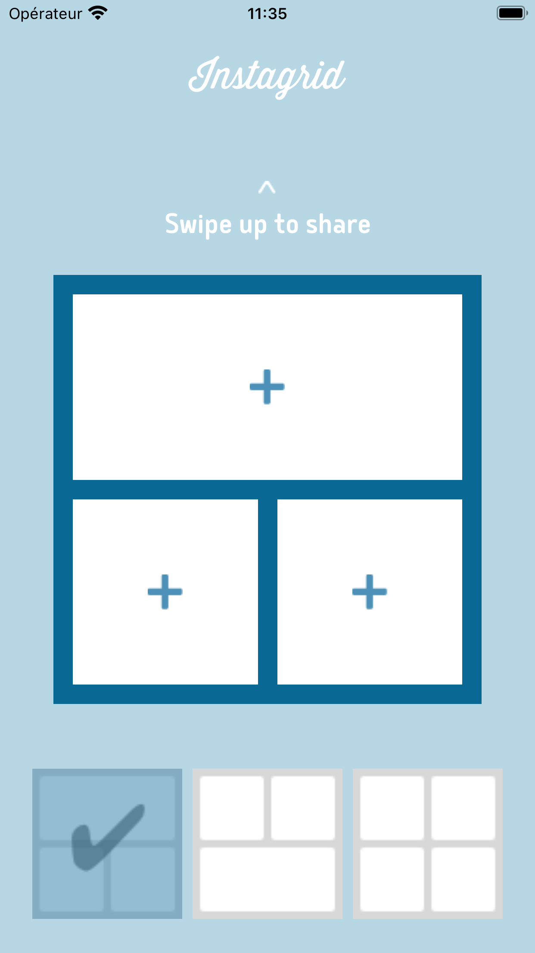
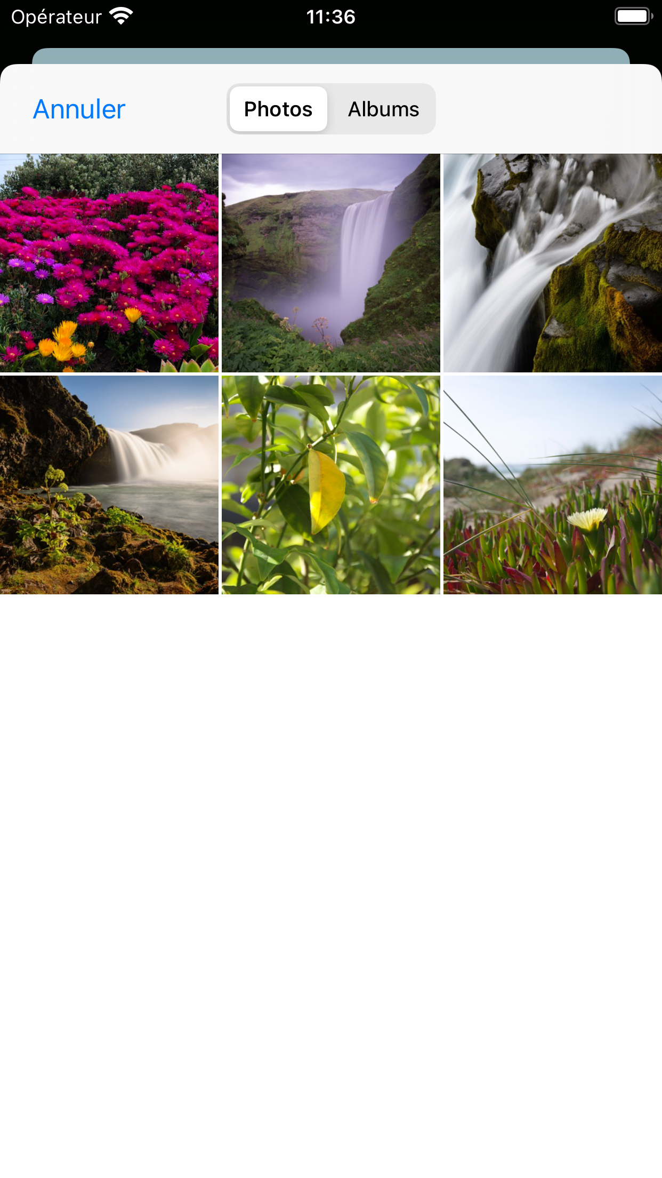
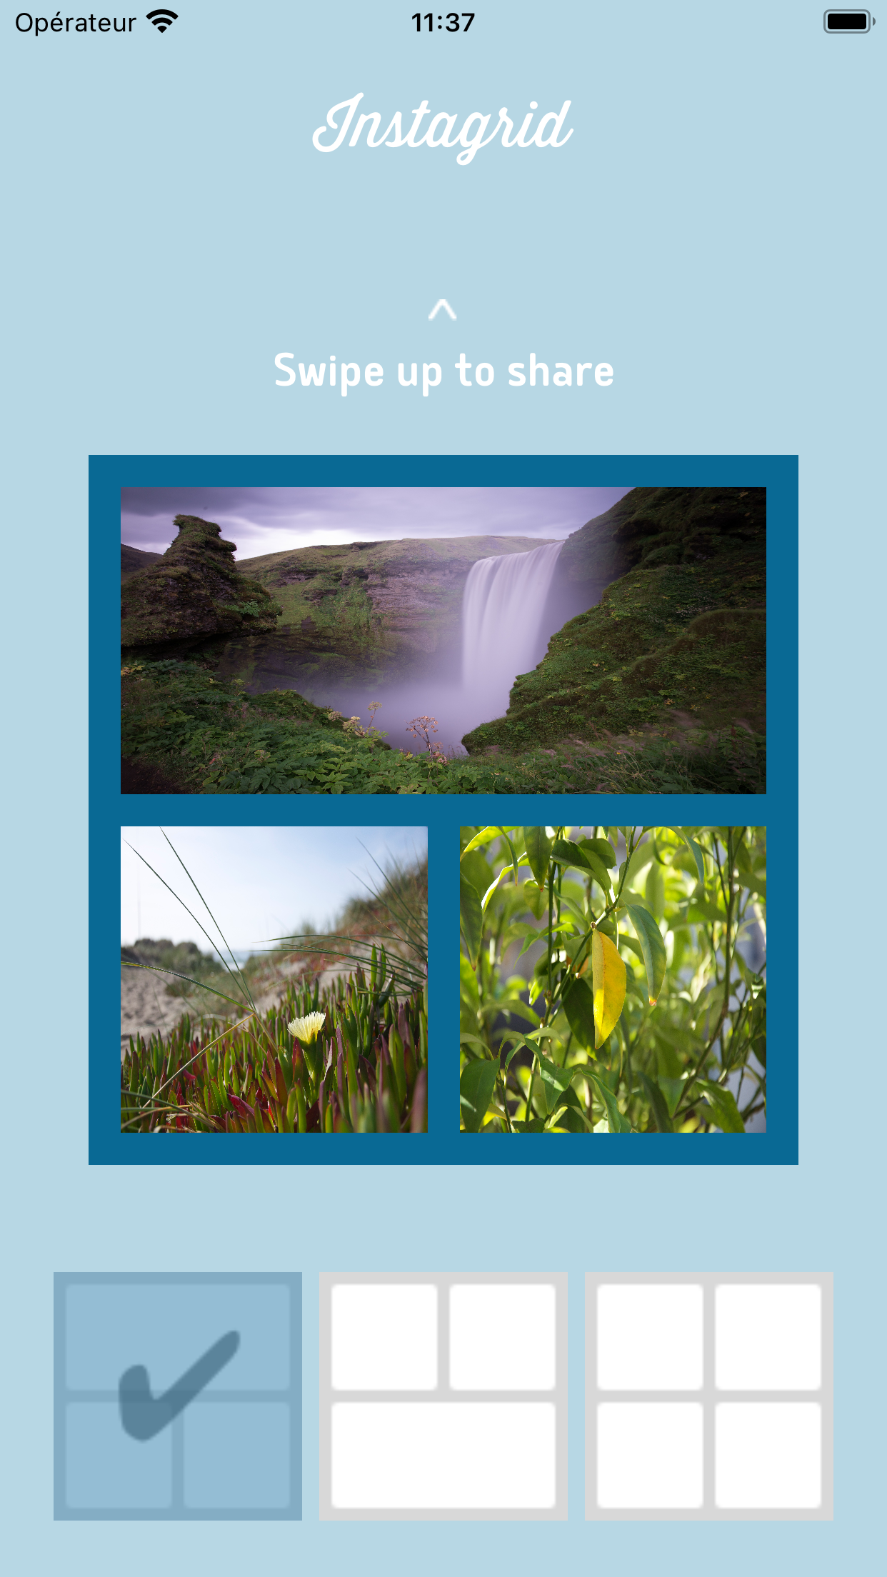
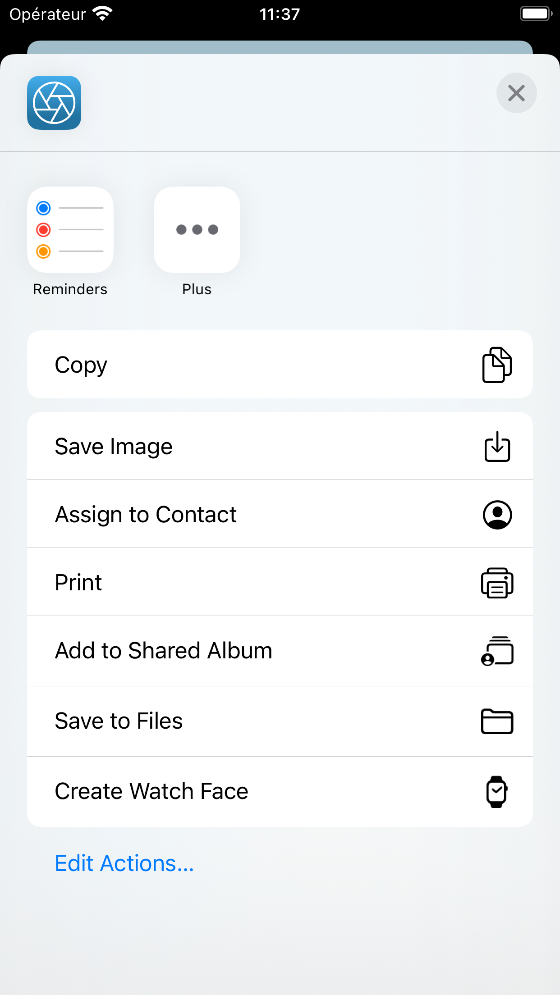

Fonctionnement
2
3
4
5
1
Sélection de disposition
Appui des boutons
Sélection des images
Swipe Up pour partager
Sélection de l’application pour partager

Slide 3

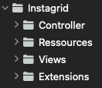
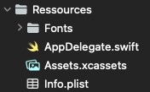
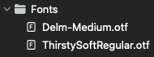


Arborescence

Slide 4
ViewController
Variables / Outlets
Actions
var currentPickButton: Int
var currentDispositionButton: Int
var destinationFrame: CGRect
var topSpace: CGFloat
var leftSpace: CGFloat
@IBOutlet weak var buttonStackView: UIStackView!
@IBOutlet weak var instagridLabel: UILabel!
@IBOutlet weak var swipeLabel: UILabel!
@IBOutlet weak var swipeLabel2: UILabel!
@IBOutlet var swipeUp: UISwipeGestureRecognizer!
@IBOutlet var swipeLeft: UISwipeGestureRecognizer!
@IBOutlet var imagesPickersButtonsList: [UIButton]!
@IBOutlet var dispositionButtons: [UIButton]!
@IBAction func imagesPickersButtons(_ sender: UIButton)
@IBAction func pressDispositionButtons(_ sender: UIButton)
@IBAction func swipe(_ sender: UISwipeGestureRecognizer)
Fonctions
override func viewDidLoad()
private func setupViews()
@objc func rotated()
private func allVisible(buttonList: [UIButton]!)
private func displayActivityController(img: [UIImage],
whichSwipe: UISwipeGestureRecognizer)

Slide 5
Extensions
UIView
ViewController:
UIImagePickerControllerDelegate, UINavigationControllerDelegate
func showImagePickerController()
func imagePickerController(
_ picker: UIImagePickerController,
didFinishPickingMediaWithInfo info: [UIImagePickerController.InfoKey : Any])
func asImage() -> UIImage
func addBackground(color: UIColor)

